Slide 1
R2D2-Skills Portal
Sub-Title
Author
Date

Slide 2
Module Objective
At the end of this module, the participants will be able to update their roles, skills and certifications on the R2D2 Skills Portal

Slide 3
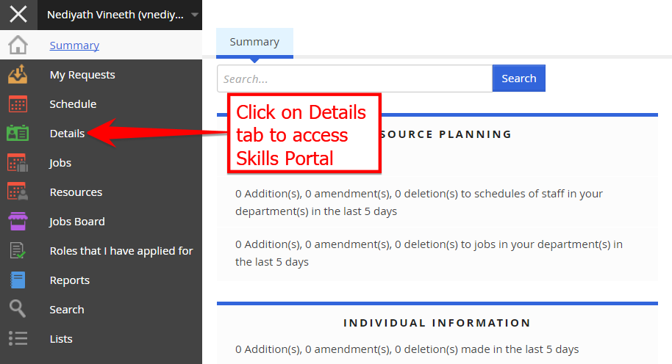
Skill Portal- Access
The R2D2 Skill portal can be accessed by using the link given below.
All resources in Capgemini have default access to the Skill Portal.
http://r2d2.capgemini.com/IWRetainWeb/IWISAPIRedirect.dll/Files/static/html/webportal.html
The link opens to the Summary page.

Slide 4
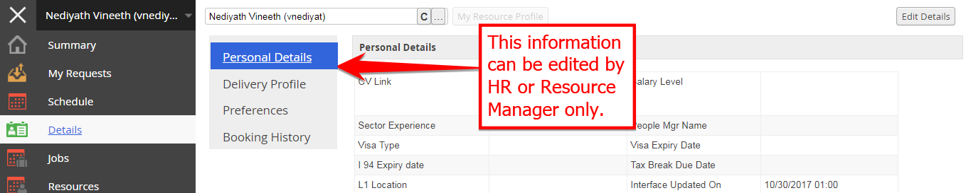
Skills Portal- Details tab- Personal Details
Information in the Personal Details tab can be updated only by HR or the Service Line
Resource Manager aligned to the resource.
The resource is expected to connect with either of them to correct information.
Depending on the information to be updated, updates can take place real time or after 24 hours.

Slide 5
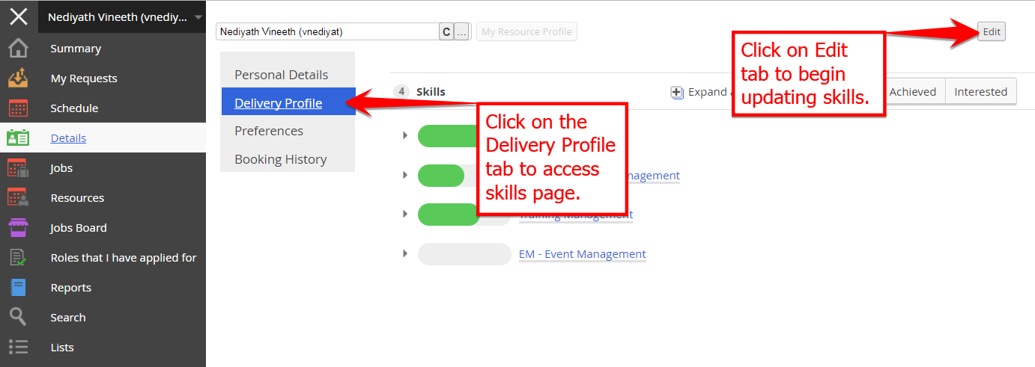
Skills Portal- Delivery Profile
Delivery Profile is most relevant for resources to update information.
Click on the Delivery Profile tab to access skills page. This page will show information on
the delivery role, delivery skills, internal certification, external certification etc.
Click on Edit tab to update or change information on this page.

Slide 6
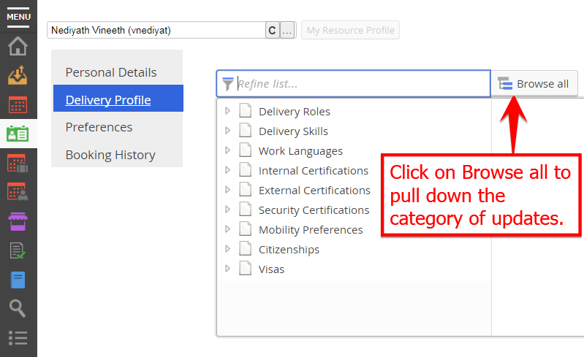
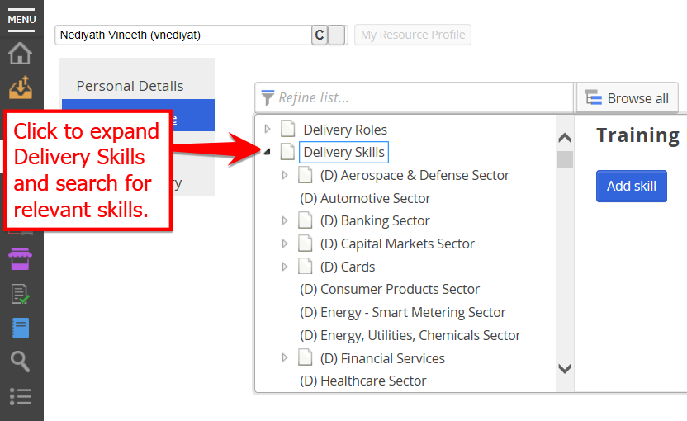
Skills Portal- Delivery Profile
Click on Browse all tab to pull down the categories to update. Delivery Roles,
Delivery Skills, Internal certifications, external certifications etc. are listed in the drop down.
Clicking on Delivery Skills will further expand the category.
Click on the relevant skill to update the Primary skill.

Slide 7
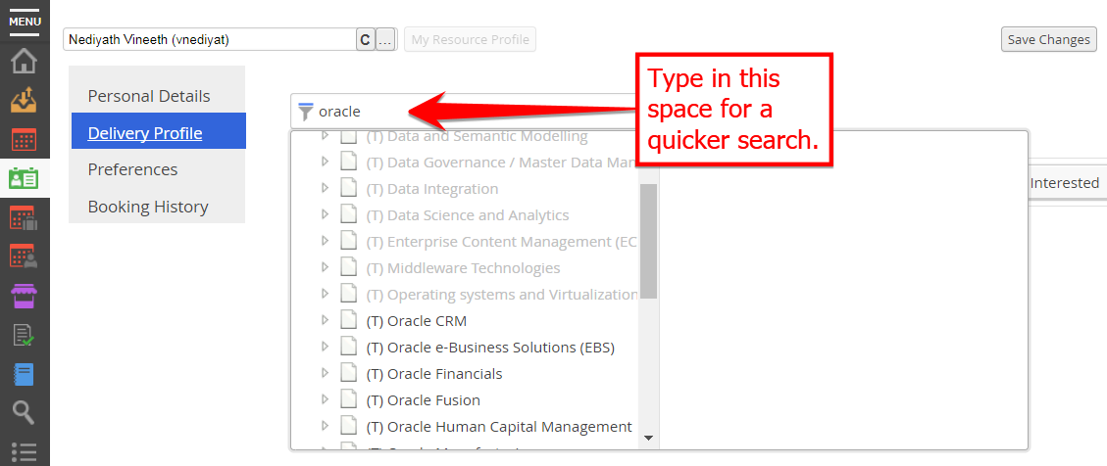
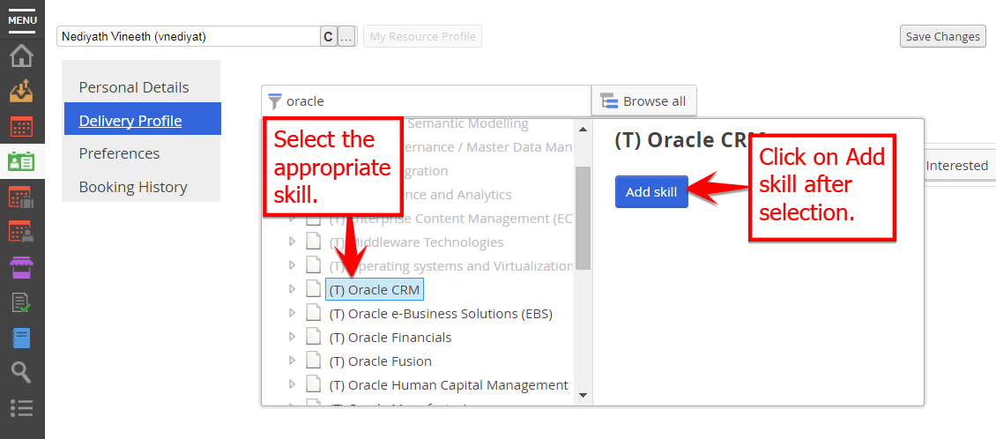
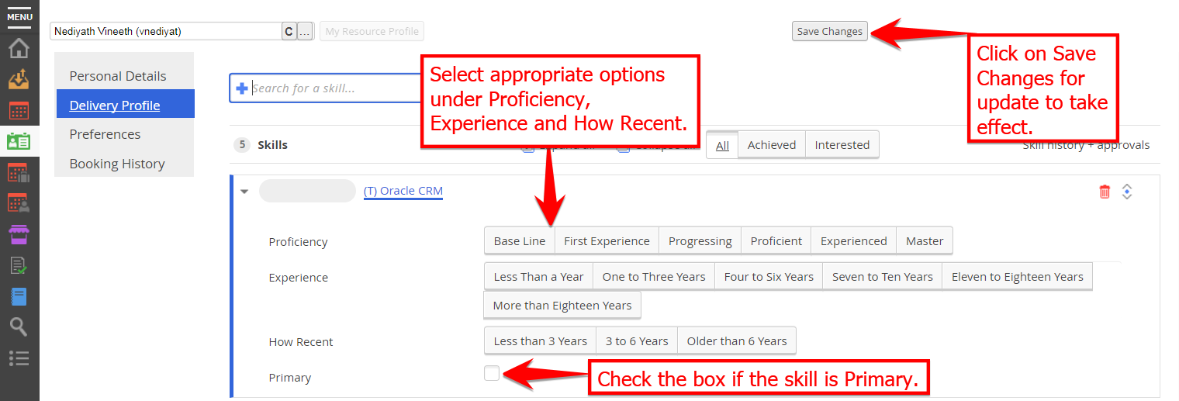
Skills Portal- Delivery Profile

Slide 8
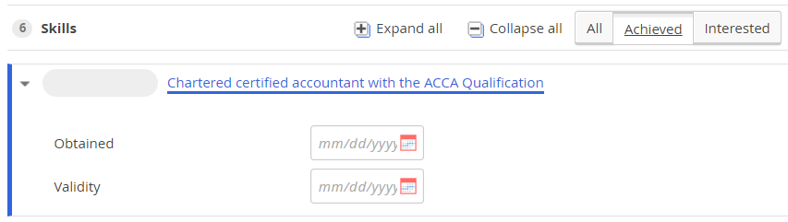
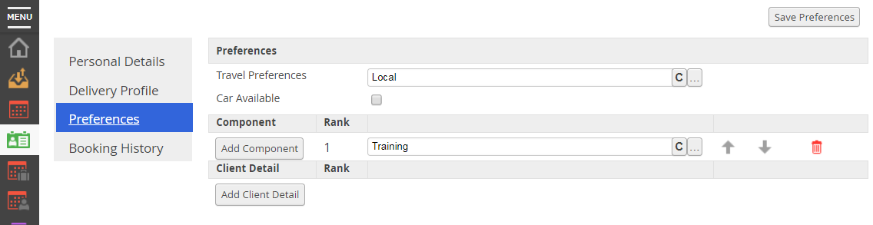
Skills Portal- Delivery Profile & Preferences
In case of External or Internal Certification, the date of obtaining the certification as well as
the validity of the certification needs to be updated.
The Preferences page allows the resource to update travel preferences

